Slide 1
IM-02 Capacity Forecaster
with NL-Query
AI-Powered Infrastructure Capacity Planning and Forecasting System
PRESENTED BY
Team - 05
Team members
P.Sreeja
G.Rekha
C.Sindhu
K.Varshitha

Slide 2


Problem Statement & Challenges
02
Capacity planning is monthly Excel work.
Capacity planning is a manual and time-consuming process that relies on analyzing historical resource metrics. Predicting future CPU, Memory, and Disk utilization is difficult, making proactive infrastructure management challenging.
Challenges:
Manual capacity planning using spreadsheets.
Reactive monitoring causes delayed response.
Unexpected outages affect business continuity.
Resource wastage due to over-provisioning.
Difficult to predict future infrastructure requirements.

Slide 3



03
Objectives
WHAT THE AI CAPACITY FORECASTER SYSTEM AIMS TO ACHIEVE
Enable proactive forecasting of CPU, memory, and storage resource usage before capacity limits are reached.
Automate anomaly detection to identify unusual infrastructure usage patterns in real time.
Deliver risk-based alerts categorized as Low, Medium, or High to prioritize operational response.
Provide natural language interaction so users can query forecasts and insights in plain English.

Slide 4
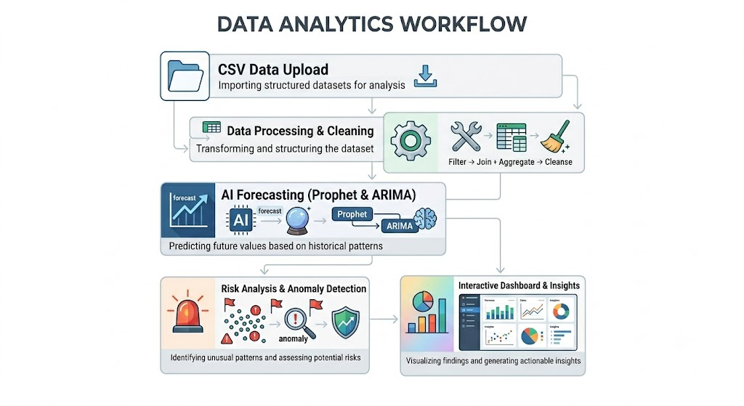
04
Solution
Overview
HOW THE AI CAPACITY FORECASTER SYSTEM WORKS
The AI Capacity Forecaster integrates time-series forecasting models (Prophet & ARIMA) to predict future CPU, memory, and storage usage. Users upload historical resource data via CSV, and the system automatically processes, analyzes, and generates forecasts. A conversational NLP interface allows users to query insights in plain English, while built-in anomaly detection flags unusual usage patterns. Risk levels are automatically assessed and visualized on an interactive dashboard for intelligent infrastructure planning.

Slide 5


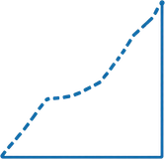

01
02
03
04
DATA INPUT
& INGESTION
PROCESSING
& ANALYSIS
FORECASTING
MODELS
DASHBOARD
VISUALIZATION
Pandas handles preprocessing, normalization, and feature engineering. Anomaly detection flags unusual usage spikes before forecasting begins.
Prophet and ARIMA models generate time-series forecasts. Risk levels (Low, Medium, High) are computed based on predicted resource thresholds.
CSV upload of CPU, memory, and network metrics. Data is validated, cleaned, and structured for pipeline ingestion via the Streamlit interface.
Interactive graphs, breach predictions, and NL query results are rendered in real-time on the Streamlit dashboard for actionable insights.
The AI Capacity Forecaster follows a modular end-to-end pipeline: raw infrastructure data flows through ingestion, preprocessing, predictive modeling, and anomaly detection before surfacing results on an interactive dashboard.
Architecture
Overview

Slide 6
06
Technology Stack
CORE TECHNOLOGIES POWERING THE AI CAPACITY FORECASTER SYSTEM
01
02
03
04
PYTHON
STREAMLIT
PANDAS & NUMPY
PROPHET & ARIMA
Data ingestion, preprocessing, transformation, and CSV handling
Core programming language for data processing, modeling, and backend logic
Interactive web-based UI framework for dashboard and user interface
Time-series forecasting models for predictive resource planning

Slide 7
07
Data Input & Processing
DATA PIPELINE: FROM RAW INPUT TO MODEL-READY FEATURES
02
04
CSV
UPLOAD
PREPROCESSING & CLEANING
Import resource usage data via CSV file with timestamps, CPU, memory, and network metrics.
Handle null values, remove duplicates, normalize data, and resample to uniform time intervals.
FEATURE
ENGINEERING
DATA VALIDATION
01
03
Generate lag features, rolling averages, and trend indicators as model-ready input variables.
Check schema integrity, detect missing fields, and flag malformed or out-of-range entries.

Slide 8

Forecasting Models
PROPHET MODEL
2x
Prophet, developed by Meta, decomposes time-series data into trend, seasonality, and holiday components. It handles missing data and outliers gracefully. In AI Capacity Forecaster, Prophet captures weekly and monthly usage cycles to predict CPU, memory, and storage demand with high interpretability.
01
FORECAST ACCURACY BOOST
ARIMA MODEL
ARIMA (AutoRegressive Integrated Moving Average) models stationary time-series data using past values and error terms. It excels at short-term forecasting with autocorrelated patterns. The system auto-selects optimal (p,d,q) parameters to accurately model infrastructure resource consumption trends.
02
PROPHET MODEL
Trend and seasonality decomposition for time-series forecasting.
ANALYTICAL APPROACH
ARIMA MODEL
Both models run in parallel on uploaded CSV data. Forecast outputs are compared and combined using a weighted ensemble strategy. This dual-model approach ensures robustness across varying data patterns, reducing prediction error and improving breach detection accuracy for infrastructure planning.
Statistical modeling of autocorrelated time-series data patterns.
03
COMBINED APPROACH
Ensemble of both models for robust and reliable predictions.

Slide 9

Features
🗣️ Natural Language Query
Users can interact with the system using simple English and instantly receive forecasting insights.
Examples:
• When will CPU usage exceed 80%?
• Show memory forecast for the next 7 days.
🔍 Anomaly Detection
Continuously monitors resource utilization and identifies unusual spikes or drops in CPU, Memory, and Storage usage, enabling early issue detection and proactive alerts.
⚠️ Risk Analysis
Forecasted resource usage is categorized into risk levels for better decision-making:
🟢 Low Risk (<60%) – Normal operation
🟡 Medium Risk (60–79%) – Monitor closely
🟠 High Risk (80–100%) – Immediate attention required

Slide 10

Results & Benefits
Results
Successfully predicts CPU, Memory, and Storage usage.
Detects unusual resource usage patterns.
Provides risk alerts and forecasting insights through a dashboard.
Supports natural language queries for easy user interaction.
Benefits
Reduces manual monitoring effort.
Helps prevent system downtime.
Improves resource utilization and planning.
Enables proactive decision-making.
Conclusion
AI Capacity Forecaster predicts future CPU, Memory, and Storage usage using historical data.It identifies potential issues early and predicts the date when resources may reach critical levels.The system provides alerts and insights through an interactive dashboard.
95%
FORECAST ACCURACY RATE

